Slide 1

Ruby on Rails

Slide 2
About today…
Ruby on Rails
Implementing Background Jobs

Slide 3

Implementing
Background
Jobs

Slide 4

Introduction to Background Jobs
Purpose
Execute tasks asynchronously in Rails applications
Example
Sending email notifications after user registration without making users wait

Slide 5

Why Use Background Jobs?
Benefits of Background Jobs
Efficiency
Keep your app responsive by offloading time-consuming tasks
Reliability
Ensure critical tasks complete, even if there are issues during regular operations

Slide 6

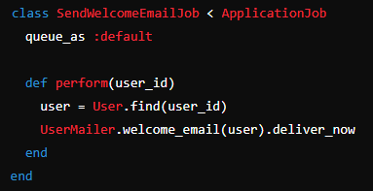
Setting Up Active Job
Overview
Active Job simplifies creating and managing background tasks
Steps
Generate a Job
Create a job to send a welcome email.
Define Job Logic
Implement sending email logic inside the job class

Slide 7
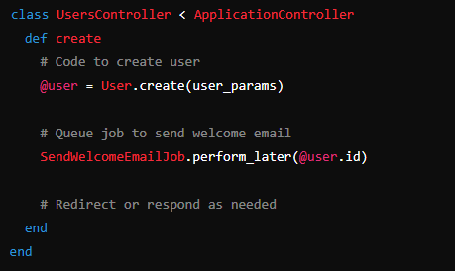
Queuing Jobs
Starting Jobs
Enqueuing Jobs
Initiate jobs with specific arguments from controllers or other jobs
Example
Enqueue the SendWelcomeEmailJob when a new user signs up

Slide 8

Using Sidekiq for Background Processing
Why Sidekiq?
Efficient Processing
Handles jobs quickly using Redis for background processing
Integration
Enhance your Rails app with Sidekiq's advanced features like retries and prioritization

Slide 9



Add Sidekiq to Gemfiles
Save the file and then run

Slide 10


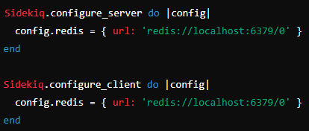
Start Sidekiq
Run the Sidekiq executor to set up its configuration and models
Create initializer “config/initializers/sidekiq.rb”

Slide 11
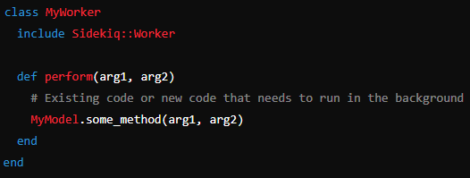
Job Creation
Create a worker class that includes Sidekiq::Worker. You can place this class in the app/workers directory

Slide 12

Job Invocation
Replace existing background job library with Sidekiq
Sidekiq can be used to handle long-running tasks, send emails, process files, etc., without blocking the main application thread. You can refactor your existing methods that require background processing to use Sidekiq workers

Slide 13
Monitoring and Handling Errors
Monitoring Jobs
Sidekiq Dashboard
Monitor job queues and performance metrics in real-time
Handling Errors
Retry Mechanism
Configure jobs to automatically retry on failure, ensuring tasks are completed successfully

Slide 14


Slide 15

What is the primary purpose of implementing Background Jobs in Rails applications?
Which Rails component simplifies the creation and management of background tasks?
Which method is used to enqueue a job for sending a welcome email after a user signs up?
What is the primary advantage of using Sidekiq for background processing in Rails?
How can you monitor job queues and performance metrics in Sidekiq?

